Slide 1
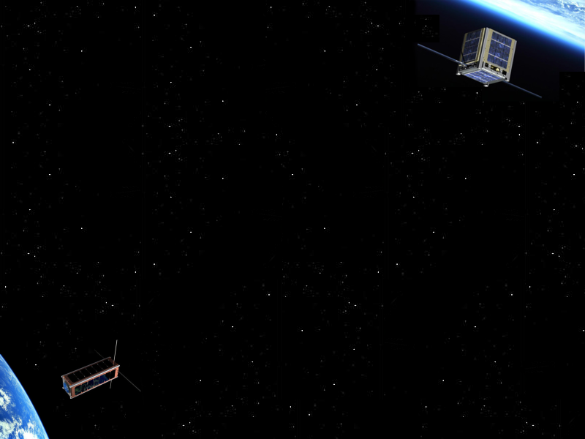

CubeSat
By
Soufiane BAGHOR <baghorsoufiane@gmail.com>
Jérôme SKODA <contact@jeromeskoda.fr>
Contents
1. What is CubeSat?
2. On-Board Computer
3. Ground station
Conclusion
Notes:
1

Slide 2
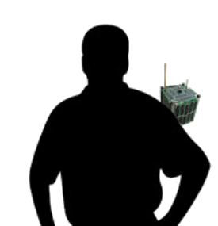
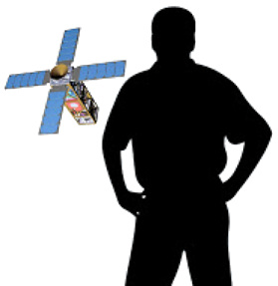
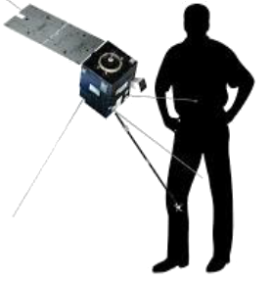
What is CubeSat?
PocketQube
0,5 Kg
EyeSat
4 Kg
Demeter
130 Kg
Corot
630 Kg
Pleiades
1 000 Kg
0kg
Pico
1kg
Nano
50kg
Micro
200kg
Mini
800kg
20/11/2017
CubeSat by Soufiane BAGHOR and Jérôme SKODA
2

Slide 3
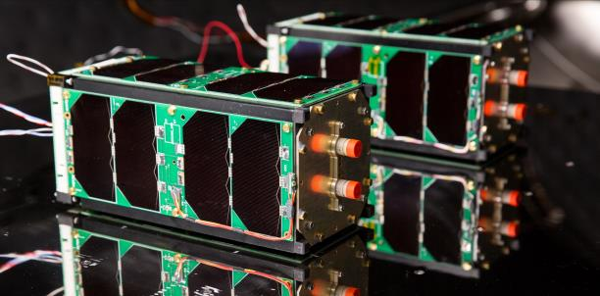
What is CubeSat?
For space research
Miniaturized
Simple 1U: 10×10× 10 cm
Double 2U: 10×10× 20 cm
Triple 3U: 10×10× 30 cm
Etc 12U: 10×10× 120 cm
Lowcost
Rapid development
Modular design
COTS hardware
Figure 1: XcubeSat (Polytechnique)
SpaceCube (Mines)
20/11/2017
CubeSat by Soufiane BAGHOR and Jérôme SKODA
3
Notes:
Speed – able to exploit parallelism, especially with data intensive applications
3

Slide 4
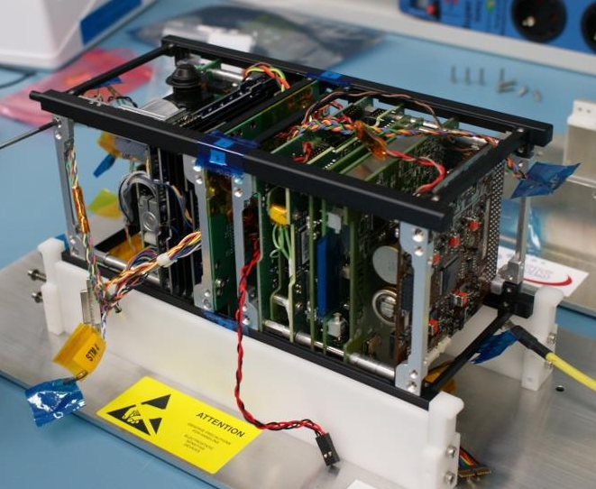
What is CubeSat?
Composition:
Attitude Determination and Control system (ADCS)
On-Board Computer
Communication system
Power system
Payload
Figure 2: Interior (QB50 precursor)
20/11/2017
CubeSat by Soufiane BAGHOR and Jérôme SKODA
4
Notes:
Speed – able to exploit parallelism, especially with data intensive applications
4

Slide 5
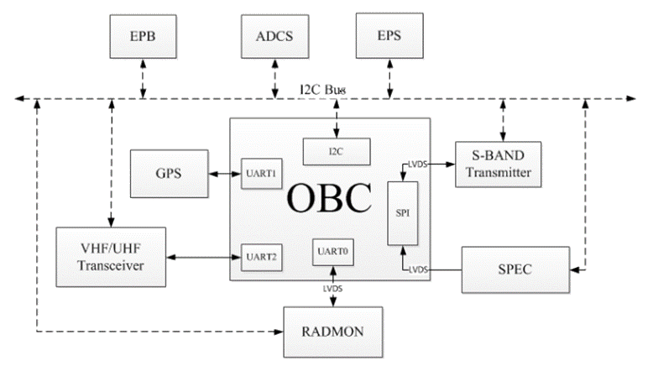
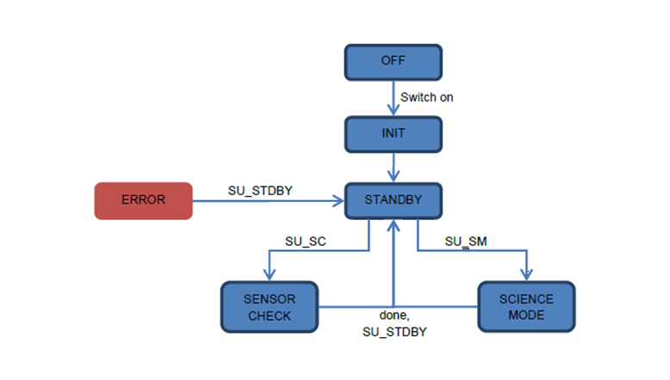
On-Board Computer
Controls all subsystems
Power efficient Microcontroller
STM32 family chips
ARM cortex M4/M7 processor
Language: C/C++
FreeRTOS
Taskscheduling
Semaphore
Queue operations
Use Finite-state machine
Good for debug, test and validation
Figure 3: System Block Diagram
Figure 4: State Transition Diagram
20/11/2017
CubeSat by Soufiane BAGHOR and Jérôme SKODA
5

Slide 6
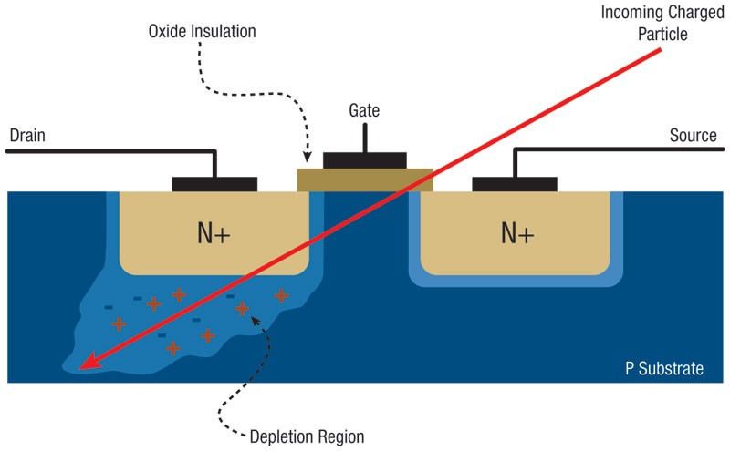
On-Board Computer
Autonomous system
Power efficient software coding
No unnecessary action in background
Handling Sleep Transitions Seamlessly
Scale Behavior Based on Machine Power State
Space contraints
Phantom Commands (PC)
Random Part Failures (RPF)
Single event upset (SEU)
Figure 5: Single event upset
20/11/2017
CubeSat by Soufiane BAGHOR and Jérôme SKODA
6

Slide 7
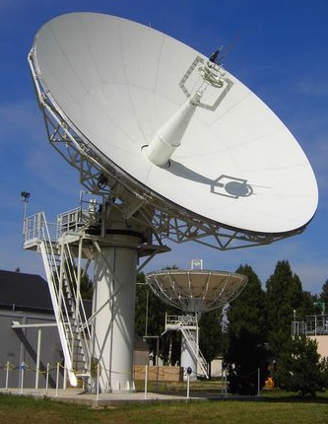
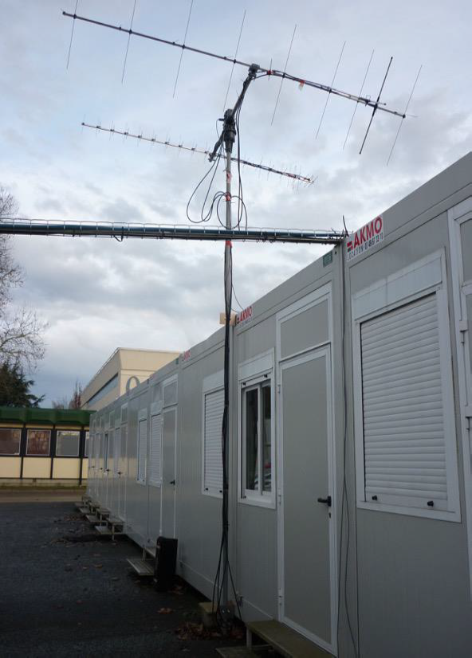
Ground station
Send Telecommand
Receive telemetry (Whole Orbit Data)
Language: Java
Antenna Tracking
Change elevation and azimuth position
Increased or reducing the frequency (Doppler shift)
Figure 6 :
Antenna bande X
(CNES Toulouse)
Figure 7:
Antenna UHF/VHF
(Ecole Polytechnique)
20/11/2017
CubeSat by Soufiane BAGHOR and Jérôme SKODA
7

Slide 8
Ground station
Control command centers
Attitude handling
Satellite tracking
Orbit determination
Figure 8: Satellite tracking (Gpredict)
20/11/2017
CubeSat by Soufiane BAGHOR and Jérôme SKODA
8

Slide 9
Conclusion
CubeSats facilitate access to space and offer more opportunities to innovation
Figure 9: PlanetLabs CubeSat Constellation
20/11/2017
CubeSat by Soufiane BAGHOR and Jérôme SKODA
9

Slide 10
References
«CubeSat: A new Generation of Picosatellite for Education and Industry Low-Cost Space Experimentation», H Heidt, J Puig-Suari, A Moore, S Nakasuka, R Twiggs, 2000
«The cubesatapproach to space access», A Toorian, K Diaz, S Lee, 2008
«Design and Qualification of On-Board Computer for Aalto-1 CubeSat »ElyasRazzaghi, 2012
« CubeSatsgetbig», www.thespacereview.com. 2012.
« Small Spacecraft Technology State of the Art », NASA 2015
« Satellite communication», Henning Vangli2010
Image
2nd Workshop CubeSat (2017)
Special thanks
Spacelab of IUT de Cachan
20/11/2017
CubeSat by Soufiane BAGHOR and Jérôme SKODA
10

Slide 11
Thanks for your keen interest!
Any questions?
Contact
Soufiane BAGHOR <baghorsoufiane@gmail.com>
Jérôme SKODA <contact@jeromeskoda.fr>
Notes:
11

